Slide 1
Project 4 - CUDA Denoiser
Recitation

Slide 2
Recap - what's with denoise?

Slide 3
Pathtraced images are often noisy/grainy
especially true for "simple" pathtracers like the basic version of Project 3
light paths "terminate" as black
rays scatter randomly on diffuse surfaces
noise worse when light paths are "unlikely" to hit light sources
scenes with small lights
scenes with lots of geometry detail
noise reduction usually doesn't scale linearly with more iterations
more time for less perceived quality improvement
oh no :(
bad news for "realtime raytracing"

Slide 4
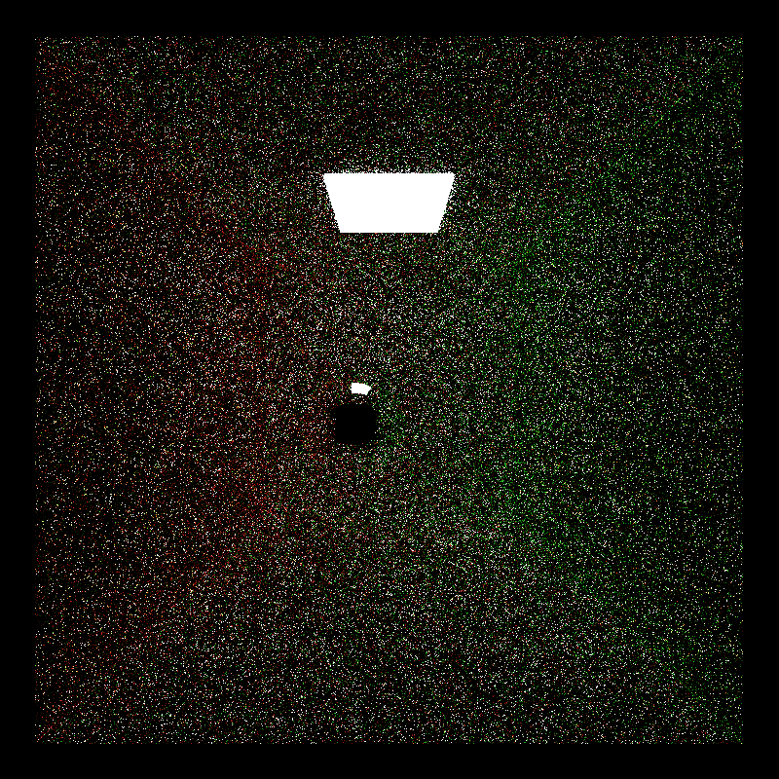
1 sample per pixel

Slide 5
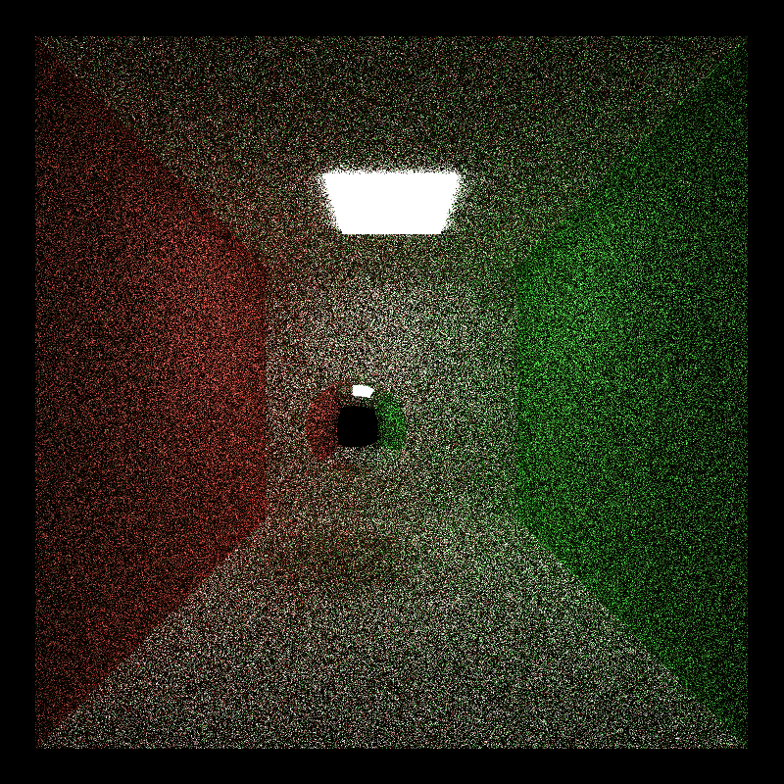
11 samples per pixel

Slide 6
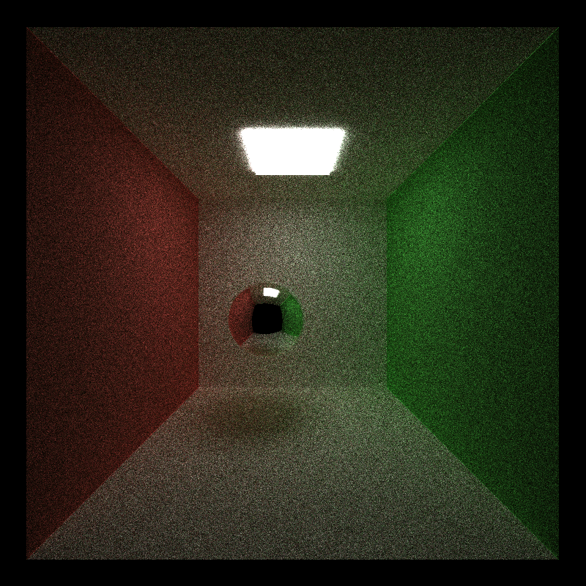
99 samples per pixel

Slide 7
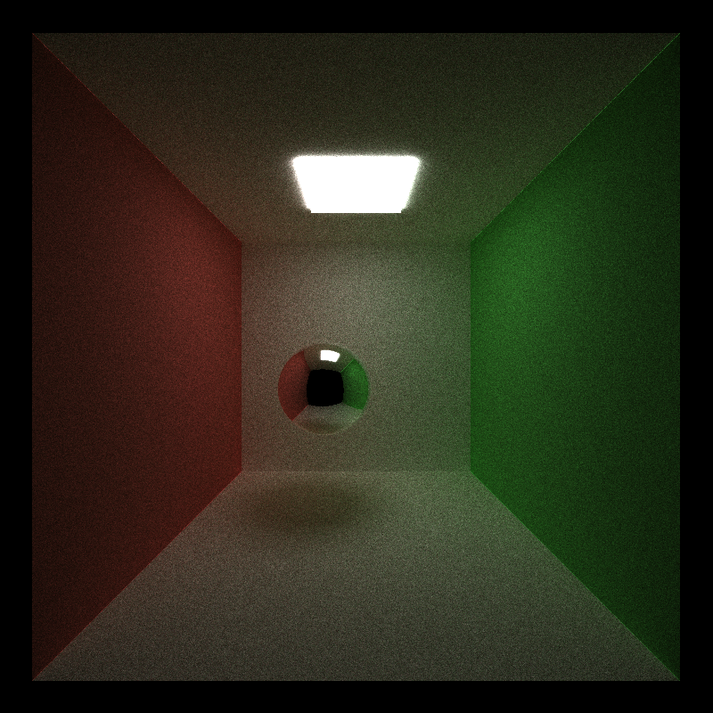
501 samples per pixel

Slide 8
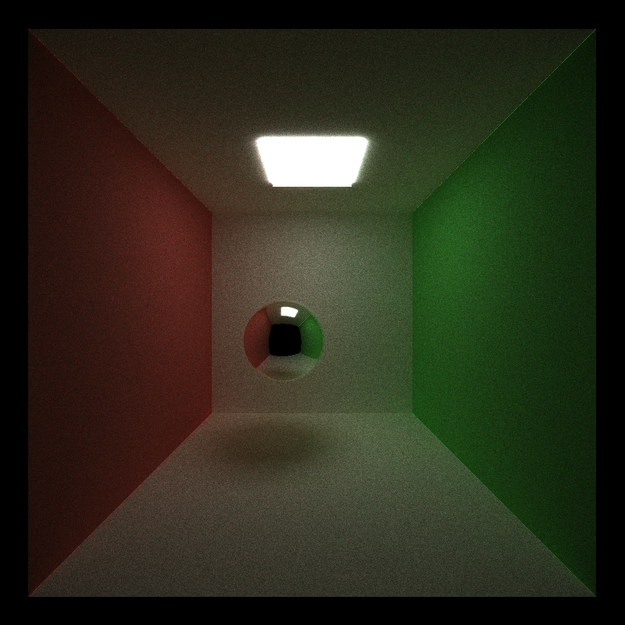
what does "2x better" even mean?!
1000 samples per pixel - does it look "2x better" than 500?

Slide 9

1000 samples per pixel - 5x zoom - still grainy!

Slide 10


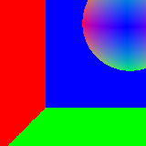

Denoising - can we just "blur" out the noise?
For some scenes and materials, sure!
Can also guide blur with more per-pixel info - basic concept of gbuffers
detect edges to preserve using per-pixel normals
detect edges to preserve using per-pixel positions
what else might be useful?
positions differ a lot- must be an edge!
normals differ a lot - must be an edge!

Slide 11
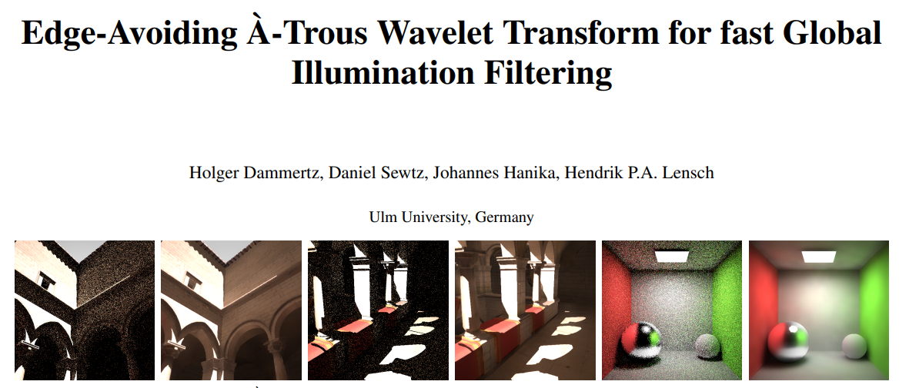
Dammertz et al.

Slide 12
Key takeaways from this paper
"À-Trous Wavelet Transform" - fancy name for technique to approximate blur filters like gaussian blur with fewer memory reads
"Edge-Avoiding" - filter is extended with G-buffer information
this paper has math and sample code! let's make some connections.

Slide 13
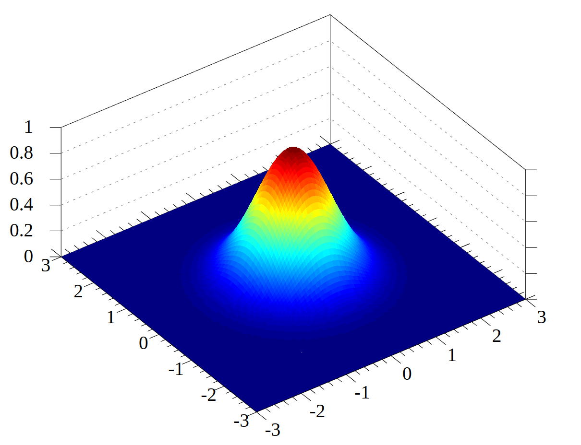
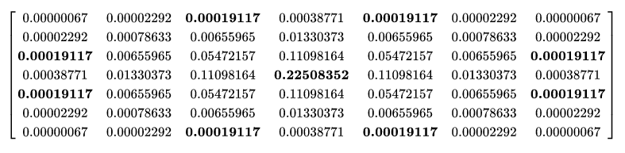
À-Trous - But first, Gaussian
gaussian blur pseudocode:
for each pixel being blurred:
sample every pixel in blur radius
multiply by a weight in a weight distribution
sometimes also called a "kernel," which can be confusing for CUDA
paper authors call this a "filter," or h
sum results and write result into result buffer
Sample 7x7 filter - https://en.wikipedia.org/wiki/Gaussian_blur
https://en.wikipedia.org/wiki/Gaussian_function

Slide 14
À-Trous - But first, Gaussian
gaussian blur pseudocode:
for each pixel being blurred:
sample every pixel in blur radius
multiply by a weight in a weight distribution
sometimes also called a "kernel," which can be confusing for CUDA
paper authors call this a "filter," or h
sum results and write result into result buffer
For a 16x16 blur width/filter, this is 256 pixel reads for each pixel blurred!

Slide 15
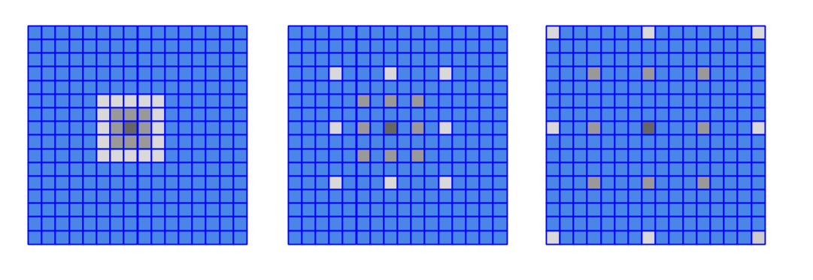
À-Trous
Approximate gaussian by iteratively applying sparse blurs of increasing size
Use a small filter, but space out the samples going through it
increasing blur size means more iterations instead of larger filter

Slide 16
À-Trous
Approximate gaussian by iteratively applying sparse blurs of increasing size
Use a small filter, but space out the samples going through it
increasing blur size means more iterations instead of larger filter
For a 5x5 filter and 16x16 blur, this is:
25 pixels read per iteration * 3 iterations
75 pixel reads per pixel blurred instead of 256 for gaussian
total number of pixel reads scales more slowly with increasing blur size

Slide 17
G-Buffers
store per-pixel information for surfaces seen beyond just raytraced color
geometry - surface position, surface normal
what else might be useful for edge detection/detail preservation?
albedo?
surface color?
Dammertz et al. get theirs from a rasterizer
use intersection info from first bounce instead - similar to first-bounce caching
considering different material types, what are some possible limitations?
reflective?
refractive?
translucent?

Slide 18
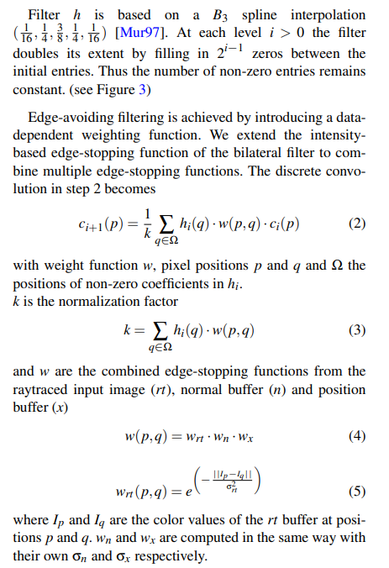
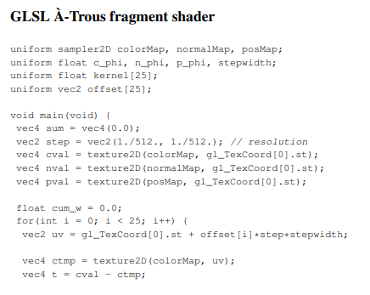
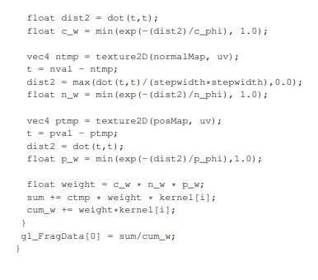
Math and Sample Code!
D:

Slide 19
Math and Sample Code!
"kernel" as in "filter," not as in "CUDA kernel"
aha! filter, aka `kernel`!
what is this?!

Slide 20
Math and Sample Code!
Grid of integer offsets to each cell in filter
what is this?!

Slide 21
Math and Sample Code!
`fragment shader` is a per-pixel program
`fragment shader` is called once for each iteration with increasing `stepwidth`
`for` loop handles gathering neighboring pixels based on the A-trous filter, which is 5x5 = 25 pixels

Slide 22
Math and Sample Code! - some correspondences

